Slide 1
TOPIC 10: Netting, Close-out, and Related Aspects
1
Introduction
2
Default, Netting and Close-out
3
Multilateral Netting and Trade Compression
4
Termination Feature and Reset

Slide 2
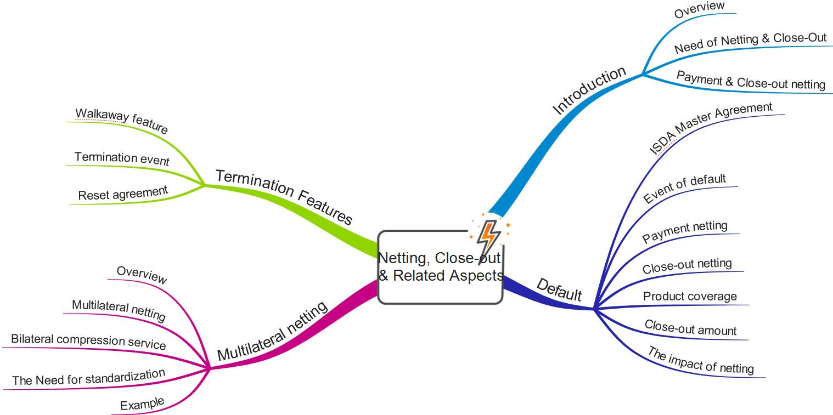
Overview

Slide 3
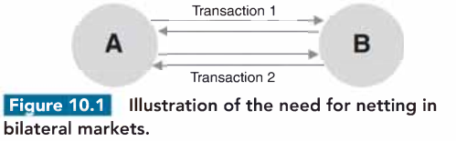
1. Introduction
Overview
CCR Mitigation
Netting: Off-setting positive and negative positions with the same counterparty --> Reduce settlement risk
Close-out: Process of terminating and settling contracts with a defaulted counterparty --> Reduce CCR
Scope of this chapter
Contractual and legal basis of netting and close-out
Impact on xVA
Related forms of risk mitigation: trade compression and break clauses
The Need for Netting and Close-out
Rationale: A bank has thousands of transactions with a defaulted counterparty --> Terminating transactions and rehedging them ASAP + Offset them
Example: A and B have 2 transactions to each other
Cash flow: 2 cash flows (same day) with gross amount cause settlement risk --> Netting
Close-out: In the event that either A or B defaults, the surviving party may suffer from being responsible for loss transaction but not be paid for the other gain transaction --> Uncertainty over cashflow payment or ability to replace the transaction
Period: Long term (maturity of the contract)
Documentation in defining the processes that would occur when one party defaults
Netting legislation: ISDA Master Agreement

Slide 4
2. Default, Netting and Close-out
The ISDA Master Agreement
Rationale: Reducing CCR + Increase efficiency --> Development in derivative market
History: In 1985, ISDA (Trade organization for derivative) introduce Master Agreement = Market standard for derivative
ISDA Master Agreement:
Components: A common core section + schedule containing adjustable terms to be agreed by both parties
Contractual terms: netting, collateral, termination events, definition of default, close-out process
Target: Remove legal uncertainty.
Negotiating terms: time-consuming but once it's completed, trading tends to occur without the need to update or change
Law: Usually English or New York
Risk mitigation features:
Posting collateral
Events of default and termination
All transactions referenced are combined into a single net obligation
The mechanics around the close-out process are defined
Events of default
Failure to pay or deliver
Breach of agreement
Credit support default
Misrepresentation
Default under specified transaction
Cross default
Bankruptcy
Merge without assumption

Slide 5
2. Default, Netting and Close-out (cont')
Payment netting
Scope: Same transaction same currency < Multiple transaction on the same day, same currency
Benefit: Reduce workload and operational risk
Case study: KFW bank ("The Germany dumbest bank"): Automated payment to Lehman Brother hours before the latter's default
Payment netting in FX transaction: Continuous Linked Settlements (CLS)
Payment vs Payment (PvP): When both deliveries arrive, CLS makes payment to both party
Close-out Netting
Issues: Payment netting is not enough
Usually, many transaction with various asset classes
Hedging or close contract through opposite position
Largely independent position (asset classes or underlying asset)
Rationale for Close-out netting: uncertainty recovery and hedging, replacement contract
Component: Close-out (terminate transaction) + Netting (offset the value of transactions --> Net balance
Scope: All transaction with various maturities, currencies, conditions (ITM or OTM),...
Mechanic: MTM at the time of default and not matching cashflow --> Single net value --> Immediately realize gain and loss + jump into bankruptcy queue
Other benefit: reduce complexity involving close-out transaction

Slide 6
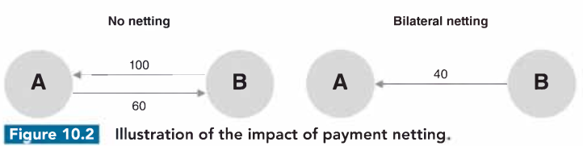
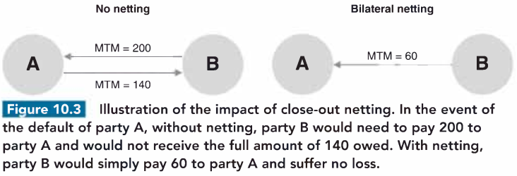
2. Default, Netting and Close-out (cont')

Slide 7
2. Default, Netting and Close-out (cont')
Product coverage and Set-Off Rights
Transactions btw banks can be divided into following categories: OTC derivatives, repo-style transaction, On-BS loan & deposit
Issue: Close-out netting is typically possible within a category but not across categories (not in straightforward documentation)
Solution: Set-offs rights allows offsetting obligations across categories --> Standardized under ISDA Master Agreement 2002
Example: Set-offs btw OTC derivatives and loans as long as the loan master agreement permits
Close-out amount
Issues: Close-out --> MTM --> Price with which bid-ask spread? (illiquid position with broad bid-ask spread
Solution: Market quotation vs "loss method"
Market quotation: minimum of 3 quotes from market markers --> What if non-standard or illiquid position
Loss method (in case of lack of quotes): Good faith & reasonable assumptions (discretion to determining party)
Difficulties in practice
Market quote: ineffective for complex and structured products --> Disputes in determination of the market quotation
Loss method: Too subjective and give too much discretion to the determining party
Contradictory decisions made by the English and US courts
Solution: definition of close-out amount - more flexible than market quote
Diluted form of market quote: Address some practical problems in achieving market quote for complex product in stressed condition
Don't require actual tradable quotes but can instead rely on indicative quotations, public sources of prices and market data
Take into account the determining party's own creditworthiness and cost of funding and hedging

Slide 8
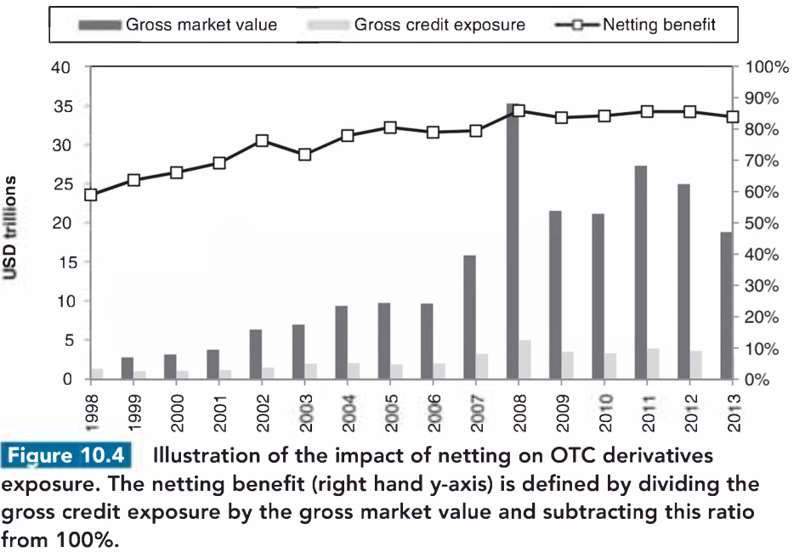
2. Default, Netting and Close-out (cont')
The impact of netting
Netting = the biggest risk mitigant for CCR (90%) --> Growth in derivative market
Note: netted position are inherently more volatile --> Create systemic risk
Netting has some subtle effects on the dynamics of OTC derivative markets
Position with a counterparty --> Close-out and enter transaction with another counterparty
If a party know an institution wanting to trade out a position --> unfavorable term to extract the maximum financial gain
Incentive to repeatedly trade with a counterparty: diversification thank to imperfect correlation btw asset classes
Note: Increase concentration risk
Change the way market participants react perception of increasing risk of a particular counterparty
Less worried as long as it's MTM is negative --> Unnecessary to terminate existing position with a trouble counterparty --> reduce systemic risk
Note: Benefits from netting are under threat from the drive towards mandatory clearing of OTC

Slide 9
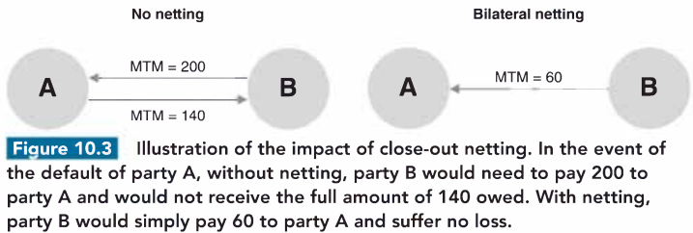
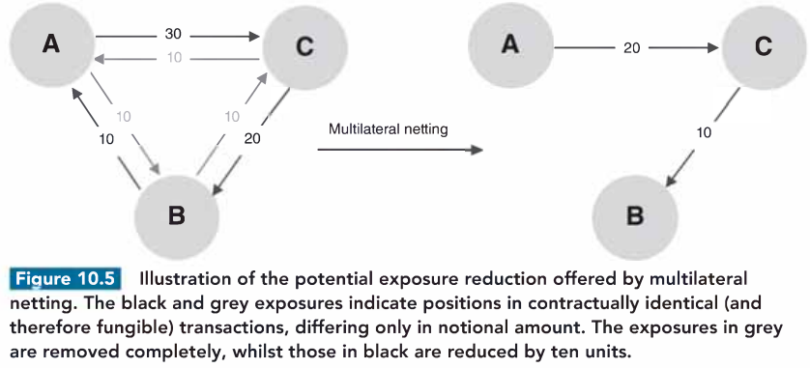
3. Multilateral netting and trade compression

Slide 10
3. Multilateral netting and trade compression
Multilateral netting
Trade compression: netting btw more than 2 counterparty → minimize notional of market position.
Trade compression can reduce:
CCR (via reducing overall exposure)
Operational cost (via reducing number of transactions)
Regulatory capital via reducing gross notional amount (in standardized approach) or increasing margin period of risk
Leverage ratio in Basel III (based on gross notional)
Legal uncertainty around offseting transactions
Billateral compression service
Compression in exchange or through CCP: netting through a central entity ~ Compression in OTC market
Example: TriOptima’s Trireduce service for major OTC derivatives such as IRS, CDS (on single names, indexes, tranches) and energy swap
Benefits: reduce redandencies → Reduce numbers and gross amount of transactions → Reduce operational cost , CCR and marginal
Process:
Legally
Comlemantary to central clearing: reduce total notional and number of contracts, complexity in close-out position in the event 1 of clearing member default
Future: Optimize the cost of transaction, across both billateral and central cleared products. Using xVAs instead of gross notional

Slide 11
3. Multilateral netting and trade compression (cont’)
The need of standardization
Rationale: OTC derivatives that don’t fit the standard product templates cannot be compressed
Example: Standardization of CDS in term of coupon (fixed premium and upfront payment) and payment date (termination date of 20th Mar, 20th Jun, 20th Sep, and 20th Dec) → Leave only reference (single name or index) and maturity
Standardization is not always posible.
For example, IRS is difficult for compression → coupond blending
Example
Total notional: Double (2 side)
Target: reduce total notional but don’t change net position
Subjective: Object to minimize (Total notional vs Large exposure), Constrain (E.g. size of position)
To minimize total notional: Netting with rings in the market
Eg. Counterparty 2,3,4 have notionals of 60,70, 85 → How much total notional can decrease?
Contrains (e.g Counterparty 1 and 3 don’t want to exposure CCR to each other) will weaken the impact of compression

Slide 12
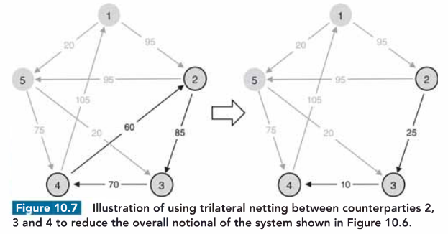
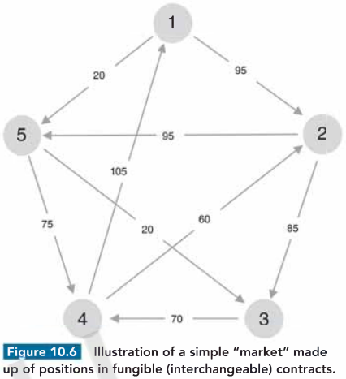
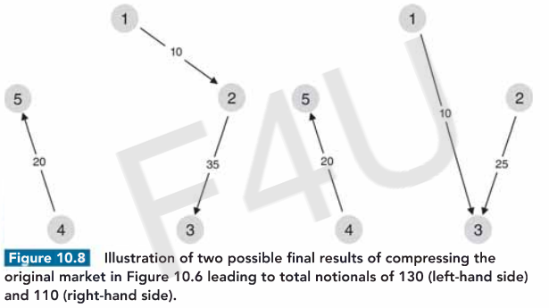
3. Multilateral netting and trade compression (cont’)

Slide 13
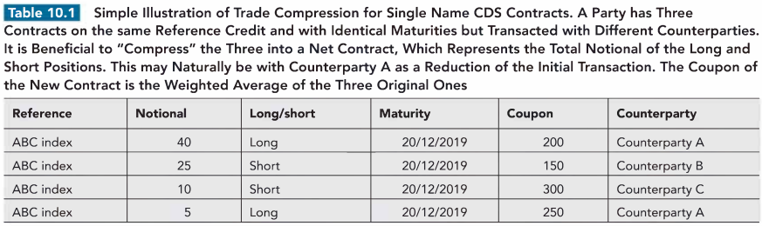
3. Multilateral netting and trade compression (cont’)

Slide 14
4. Termination Features and Resets
Walkaway features
Walkaway / Tear-up feature: A survival party can cancel the transaction with the default party
Survival party benefits from ceasing payment and not be obliged to settle amount owed to the default party
No longer common: before ISDA Master Agreement 1992
Case study: Drexel Burnham Lambert (DBL) bankruptcy in 1990
Counterparties of DBL decided not to walk away due to relatively small gains compared with the potential legal cost or reputation cost
Implicit walk away :
Case study of Enron & TXU: when Enron defaulted in 2002, TXU refused to MTM and close-out → Court → Postpone payments until the maturity date
Case study of Lehman Brother: US court (against) vs English court (Allow withholding of payment)
Criticism: unpleasant, moral hazard, additional cost for default party

Slide 15
4. Termination Features and Resets (cont’)
Termination event
Additional Termination Event (ATE): a party can terminate OTC derivatives in certain situations.
Certain situation: rating downgrade (bank) vs Market capitalization, NAV, key man departure (for unrated firms, such as hedge fund)
Action: termination or other risk-reducing actions such as posting additional collateral
Scope: usually good credit rating counterparty, long term transaction
Difficulties: Determine replacing cost in the event of termination + incorporate creditwithiness of survival party
In ISDA Master Agreement: “break clause” or “mutual put”. Mandatory, Optional or Trigger-based
Potential dangers of ATE
Risk-reducing benefit : systematic deterioration (in crisises)
Weakness in credit rating: Only last minute → unlikely useful (too late)
Cliff-edge effect: small event (E.g. 1 notch-downgrade) → Dramatic consequence (Case study: near-failure AIG)
Determination of value in the event of a termination: difficult and subjective (similar to that of close-amount)
Ralationship issue: harm relationship → Refuse to use this clause → Internal clarity around who in bank is empowered to exercise ATE
Modelling difficulty: probability of migrating rather than default → Lack of market data (such as spread) + Lack of means for hedging
In practice:
Management: Credit & sale department → xVA desk
Becoming less common due to CRM such as posting collateral, CDS. Determination of replacing cost. Negative impact on liquidity coverage ratio (posting collateral in bad time when bank need to hold liquidity buffer)
User: bank, pension & hedge fund (after GFC)

Slide 16
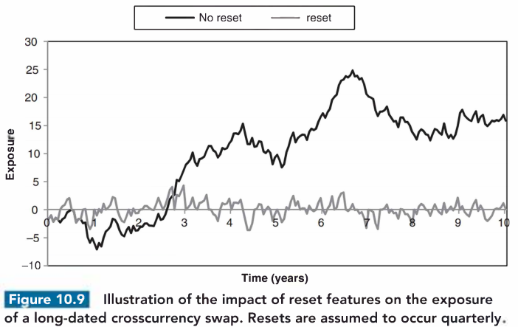
4. Termination Features and Resets (cont’)
Reset agreements
Reset agreements:
Rationale: avoid transaction becoming strongly in-the-money
Action: adjust product-specific parameters that reset the transaction to be more at-the-money
Reset date may coincide with payment date or trigged by the breach of some market value
Nature: Closing out a transaction and executing a replacement transaction (weaker form of collateralization)

